Slide 1

Codex –Beverage Market Research and Analysis
Codebasics Resume Challenge Project -6

Slide 2
Introduction
CodeX is a German beverage company that is aiming to make its mark in the Indian market. A few months ago, they launched their energy drink in 10 cities in India.
The Marketing team is responsible for increasing brand awareness, market share, and product development.
We have conducted a survey in those 10 cities and received results from 10k respondents .

Slide 3
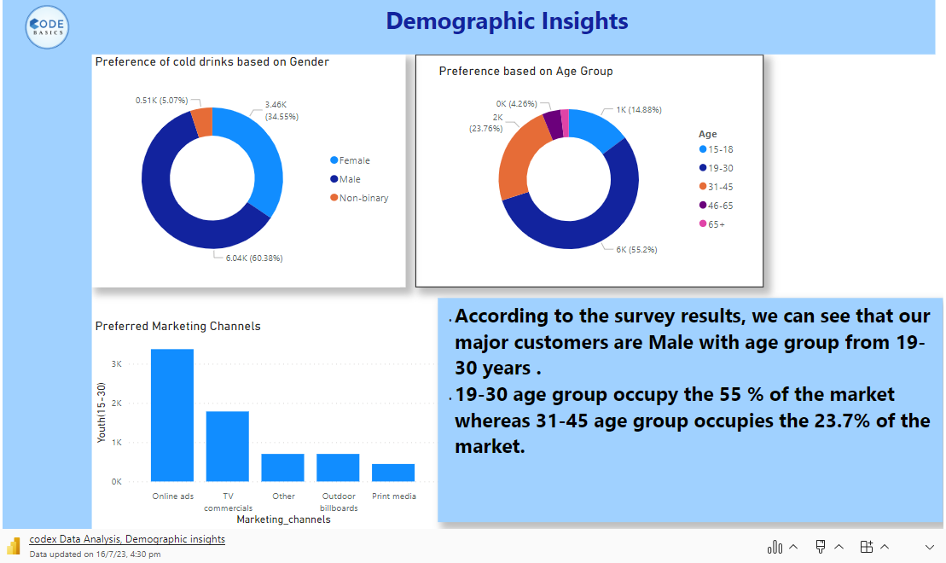

Slide 4
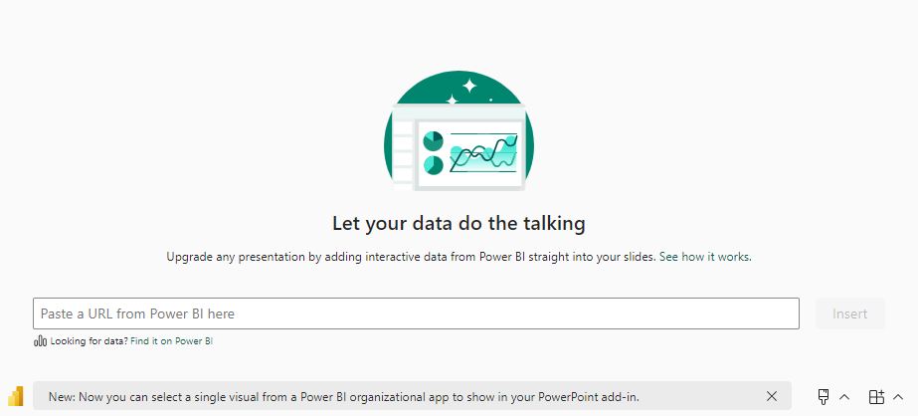
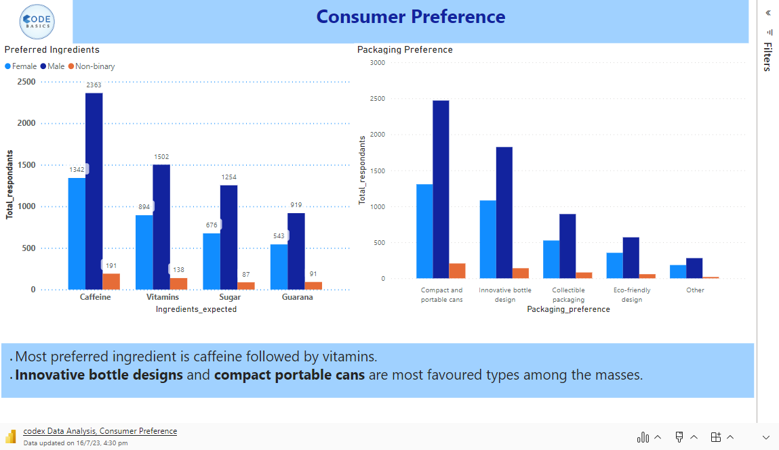

Slide 5
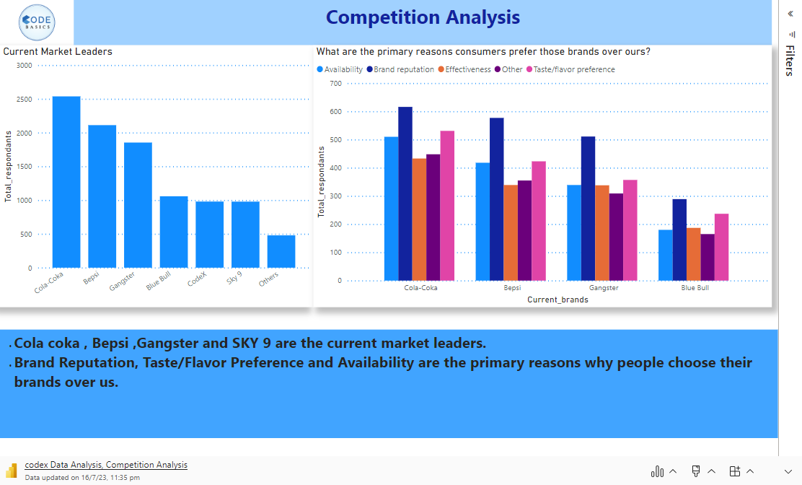

Slide 6
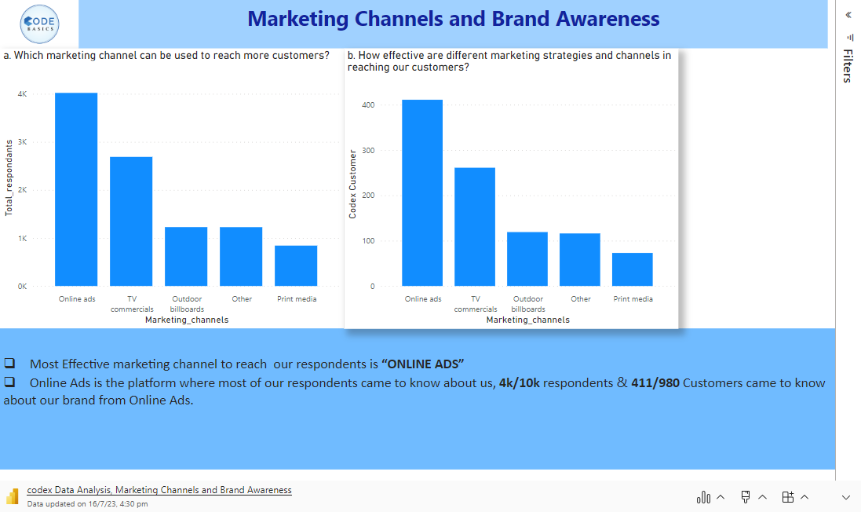

Slide 7
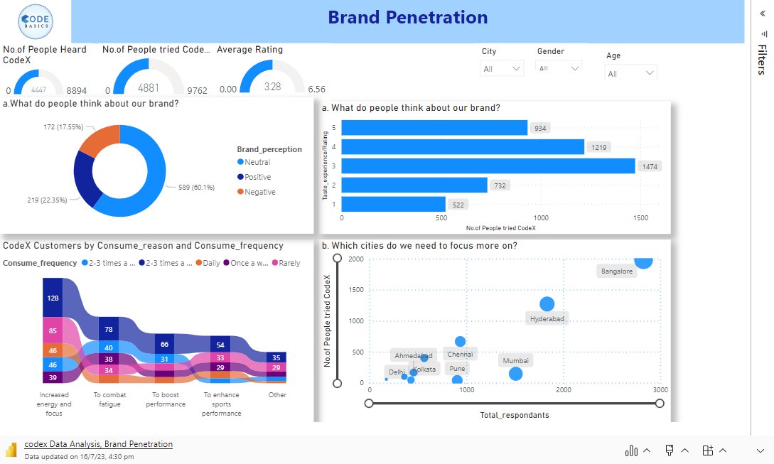

Slide 8
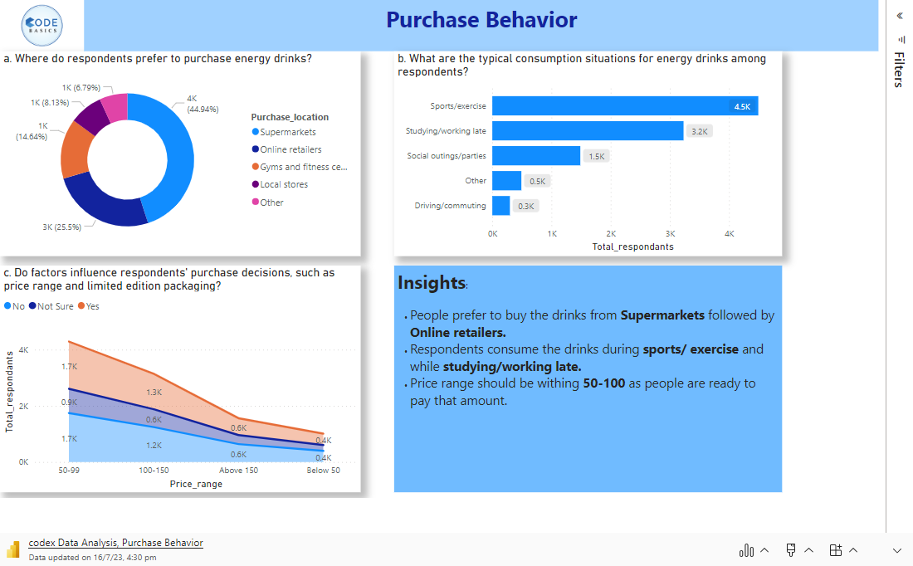

Slide 9
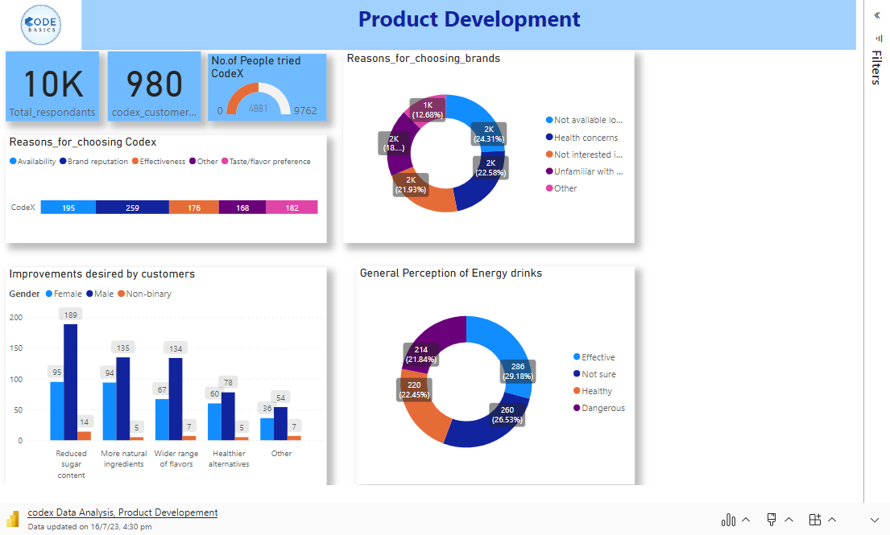

Slide 10
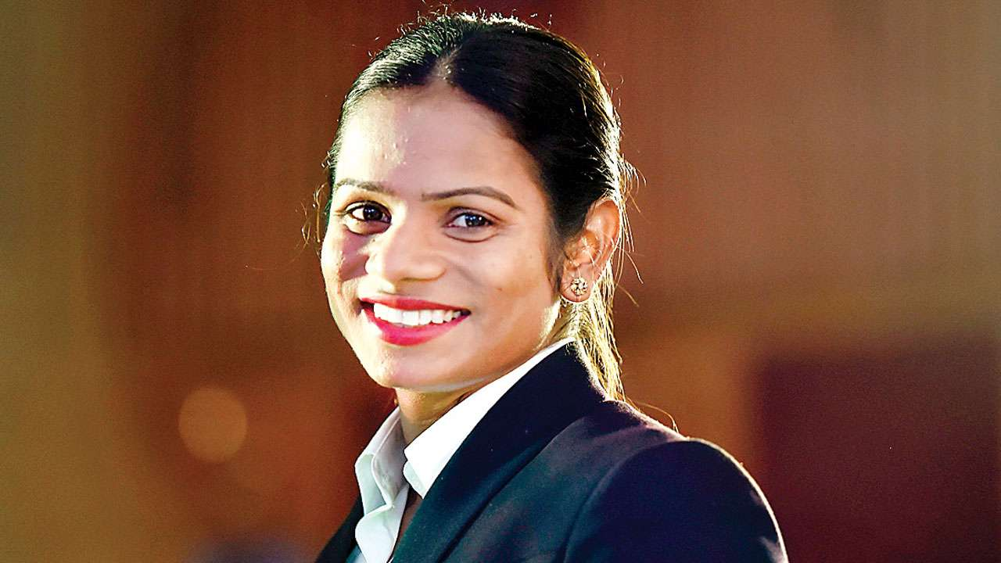
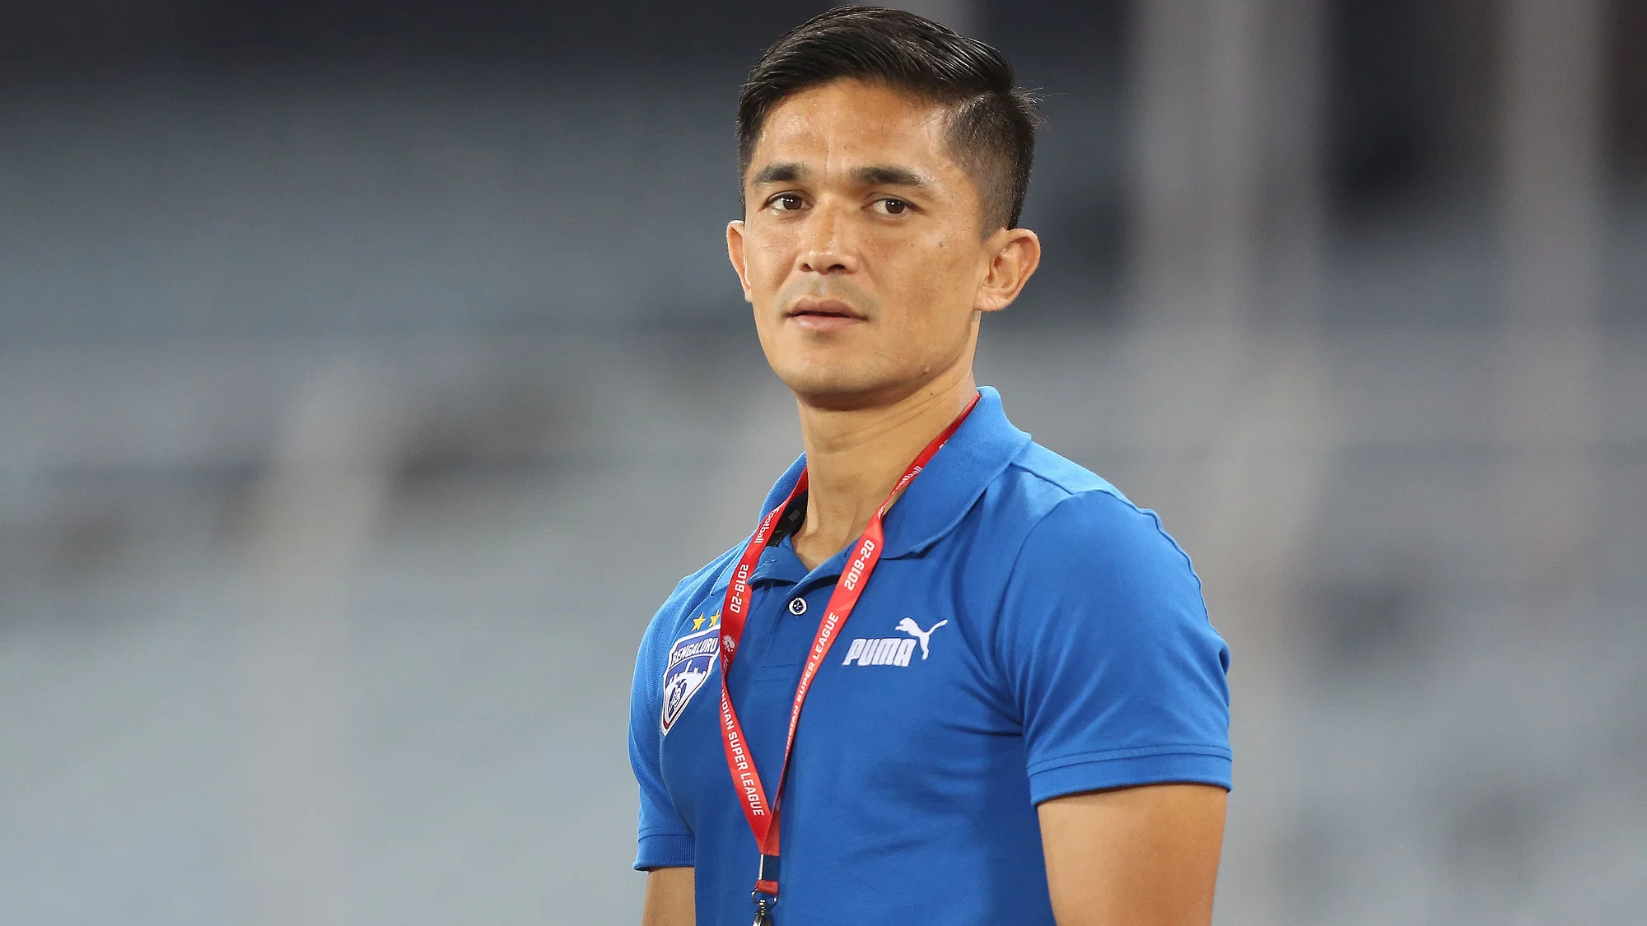
Brand Ambassador:
Dutee Chand is an Indian sprinter who has achieved numerous accolades in her career. She became the first Indian sprinter to reach the final of the women's 100m event at the 2018 Asian Games, where she won two silver medals in the 100m and 200m events. She also won a silver medal in the 100m event at the 2018 Asian Athletics Championships.
Sunil Chhetri is the all-time leading goal scorer for the Indian national team, with over 70 goals to his name. He has been instrumental in leading the Indian team to several victories, including the 2008 AFC Challenge Cup, where he emerged as the top scorer. Chhetri's goal-scoring prowess and leadership skills have earned him the captaincy of the national team.

Slide 11
Thank You

